Slide 1
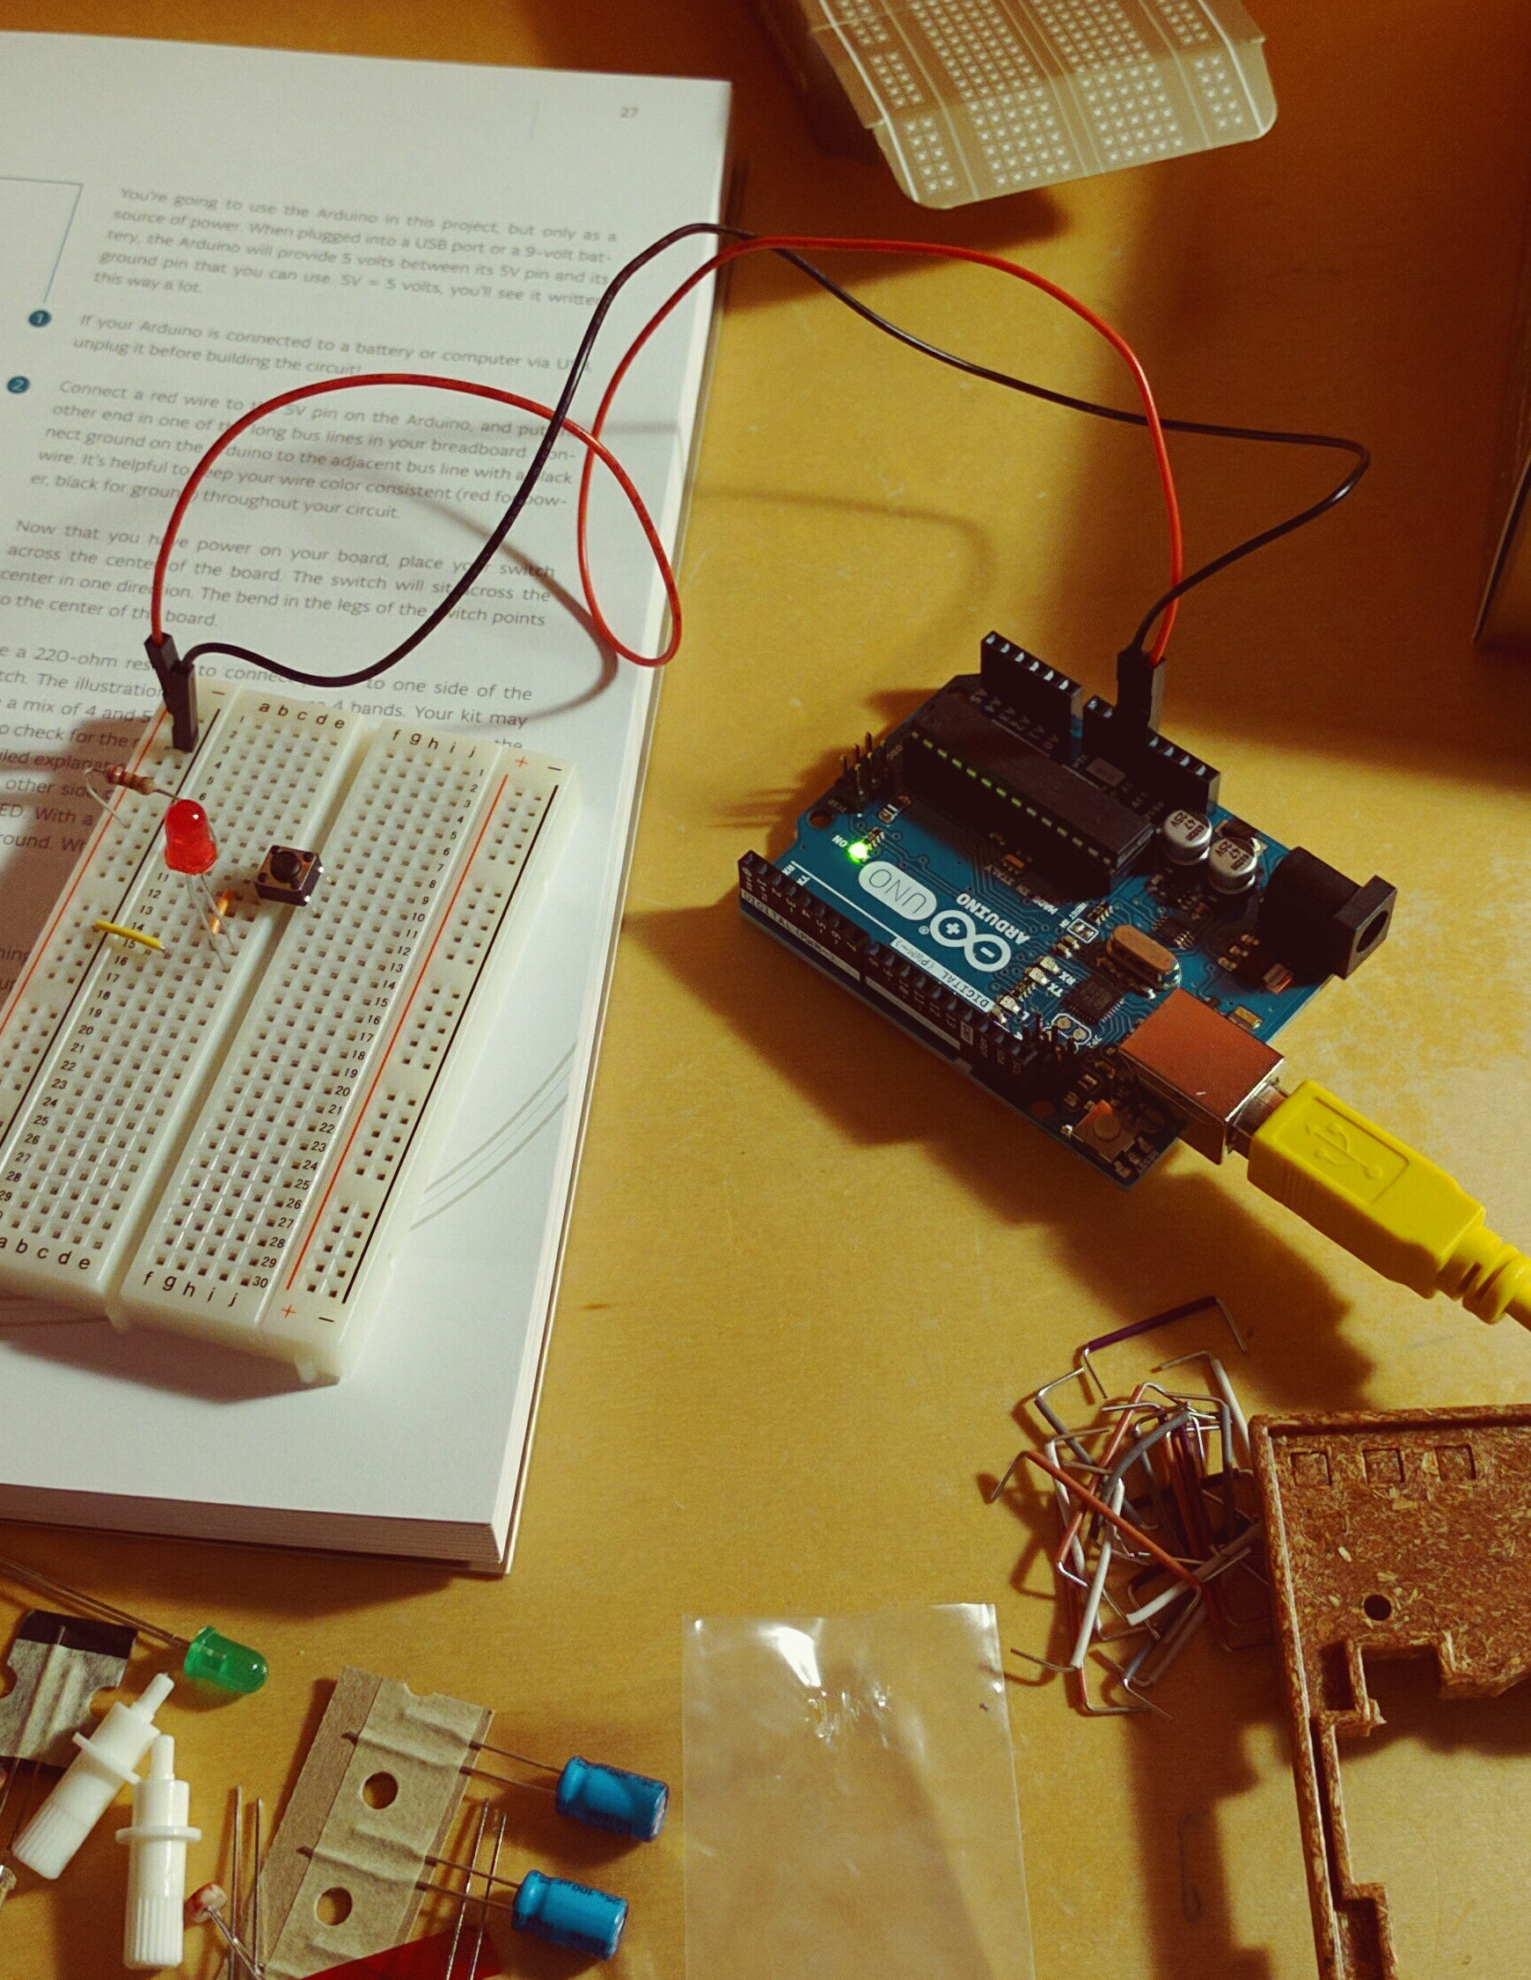
UDL MINF
Ubiquitous
2nd Sprint
&Embedded
Chemical Plant project
Team 1 Danillo Lange, Jeongyun Lee, Ronnel Mattew
Github : https://github.com/jy-977/UBQ- Danillo Lange : https://github.com/roxdan
Jeongyun Lee : https://github.com/jy-977
Ronnel Mattew : https://github.com/ron7858

Slide 2
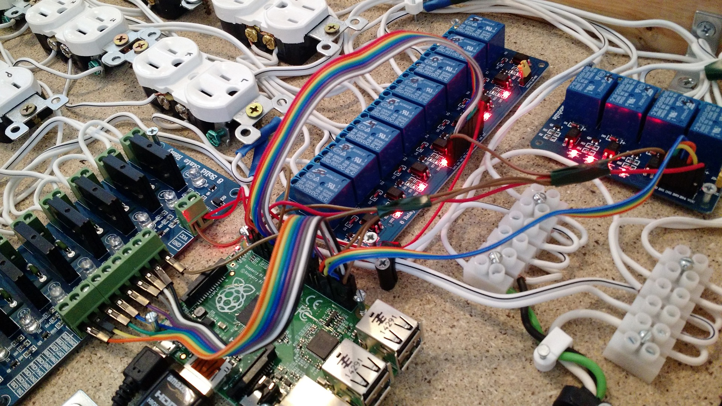
2nd Sprint
Chemical Plant project
PRESENTATION INDEX
Follow up
Briefing
3rd Sprint
Q&A
01
02
03
04

Slide 3

CO NEW VISION 2020
Follow up
01
On 1st Sprint
1st Sprint Feedbacks
SCRUM SPRINT

Slide 4

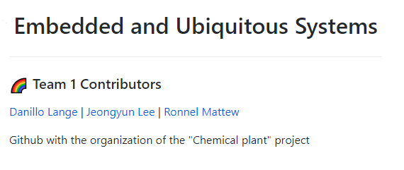
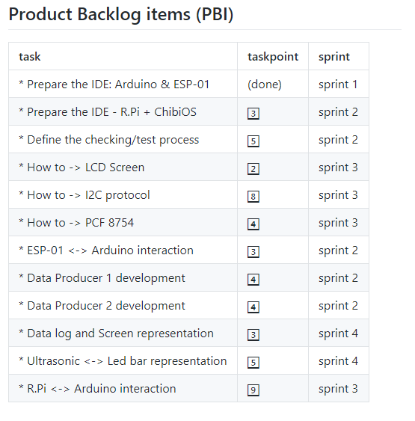
Follow up
1st Sprint Feedback
01
PBI
Score the task point for each tasks
02
Scrum Sprint Managing
Update the Scrum Sprint
Github project managing tool

Slide 5
Follow up
1st Sprint Feedback
03
User Stories
Build a system to monitor some variables of a tank container.
It is necessary to obtain the temperature and humidity of a tank container
→ Data Producer 1 : ESP 01 + DHT 11 Sensor
It is necessary to obtain the chemical compound level of tank container
→ Data producer 01 : ESP 01 + HC-SR04 Sensor
Sensor data must be sent to a remote controller.
→ ESP01 – Arduino Integration
Operator requires graphical representation of the temperature and humidity , obtained within the last 24h, in the controller.
Operator requires information of the current tank container level in real time and it must be shown in a led bar present in the controller.

Slide 6

SCRUM SPRINT
01
Components Background knowledge
Prepare the IDE – Arduino, EPS
Prepare the IDE – R.Pi +Chibi os
3 Group
4 Group
3 Group
Done
02
5 Danillo
3 Danillo
3 Yoon
4 Ron
2 Yoon
Define the Checking/ Test Process
ESP01 – Arduino interaction
Data Producer 1 Development
Data Producer 2 Development
Presentation
8 Oct-
22 OCt
03
2 Ron
8 Y / D
4 Ron
9 Y / D
2 Danillo
How to – LCD Screan
How to – PCF 8754
How to – I2C protocol
R.Pi – Arduino interation
Presentation
22 Oct
-5 Nov
04
3 Yoon
5 Danillo
2 Ron
Data log screen representation
Ultrasonic – Led bar representation
Presentation
5 Nov-
19 Nov

Slide 7
CO NEW VISION 2020
Briefing tasks
02
2nd Sprint
Danillo Lange
Jeongyun Lee
Ronnel Mattew

Slide 8

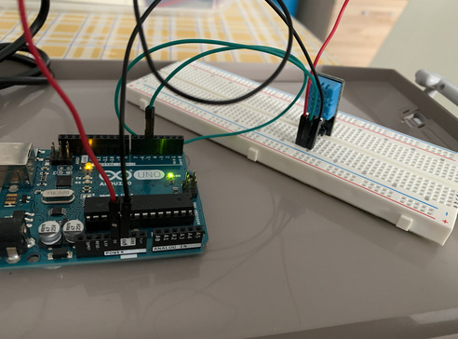
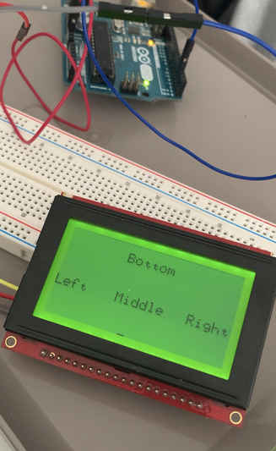
Define the Cheking/ Test Process
ESP01 – Arduino interaction
Data Producer 1 Development
Data Producer 2 Development
Presentation
Briefing the ongoing tasks
Danillo Lange
01
Define the Checking / Test Process
Raspberry Pi
Arduino Uno
ESP-01
LCD
DHT11 Sensor
Ultrasonic sensor HC-SR04
Ongoing : PCF and I2C Module

Slide 9
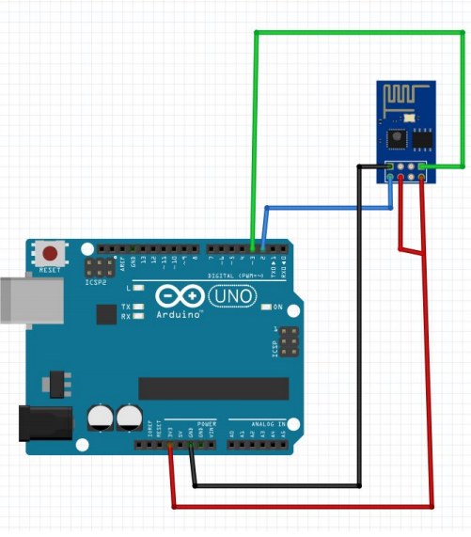

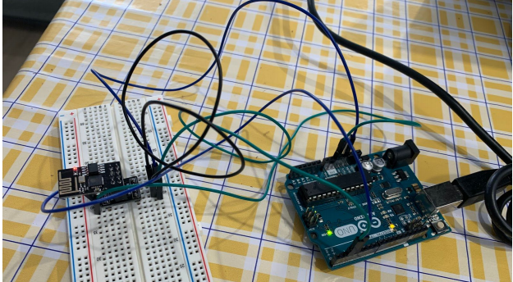
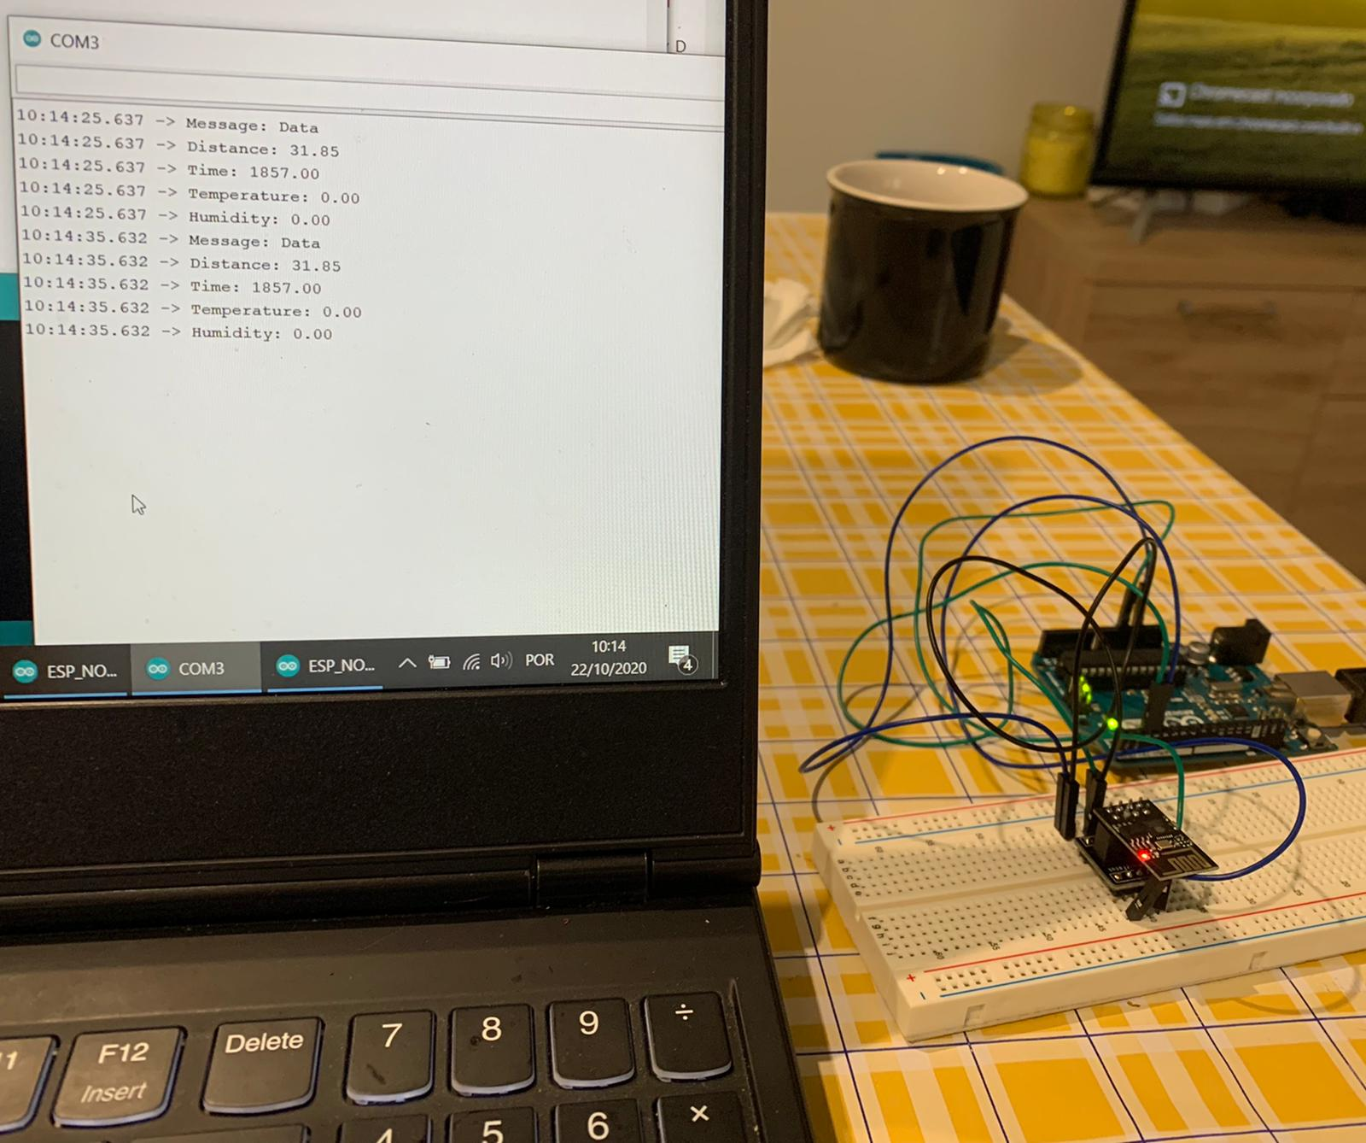
Define the Cheking/ Test Process
ESP01 – Arduino interaction
Data Producer 1 Development
Data Producer 2 Development
Presentation
Briefing the ongoing tasks
Danillo Lange
02
ESP01 – Arduino Interatction
Software Serial library: ESP-01 and Arduino communicate with serial connection
2. Set the ESP-01 as a data receiver with following code : https://github.com/jy-977/UBQ-/blob/main/documentation/Arduino_ESP8266.pdf
3. Electric connections & Building the set up
4. Testing process

Slide 10
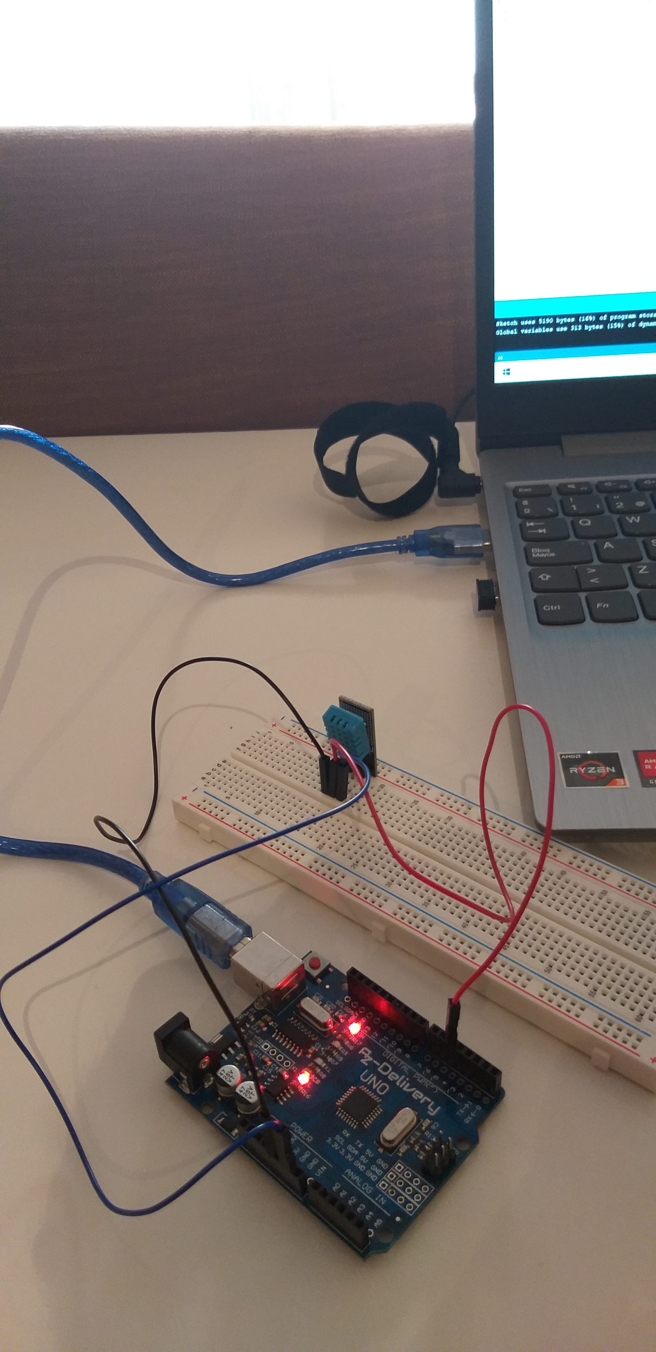
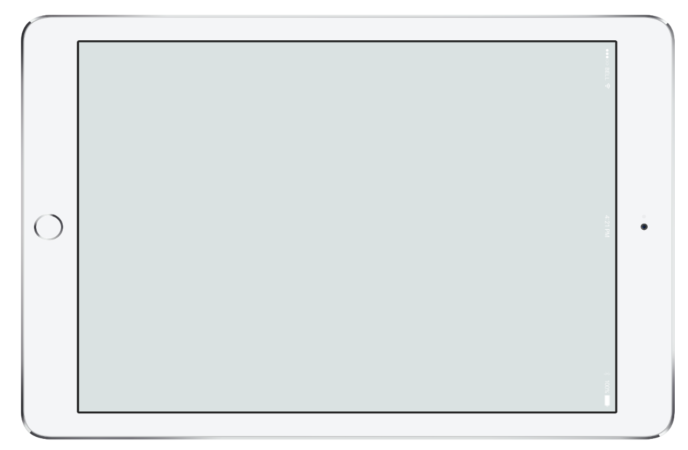
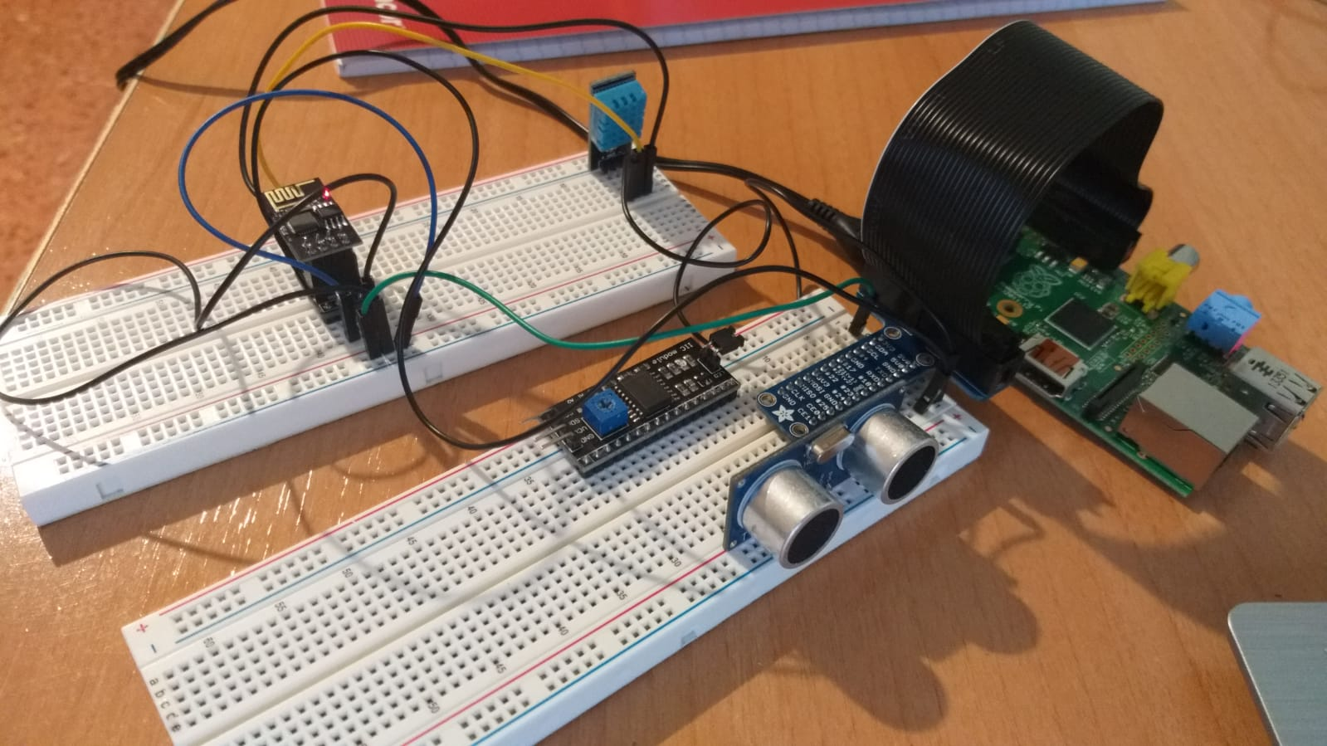
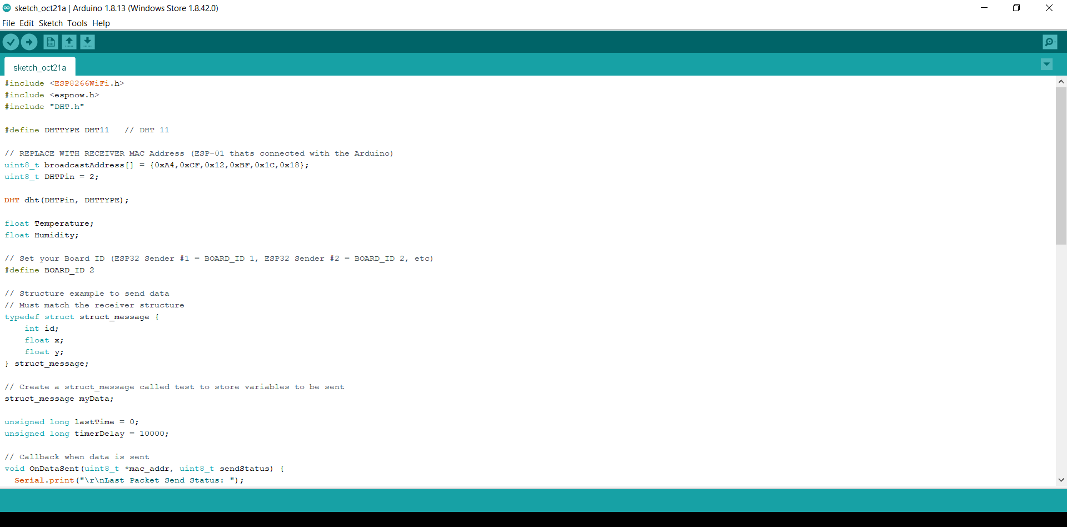
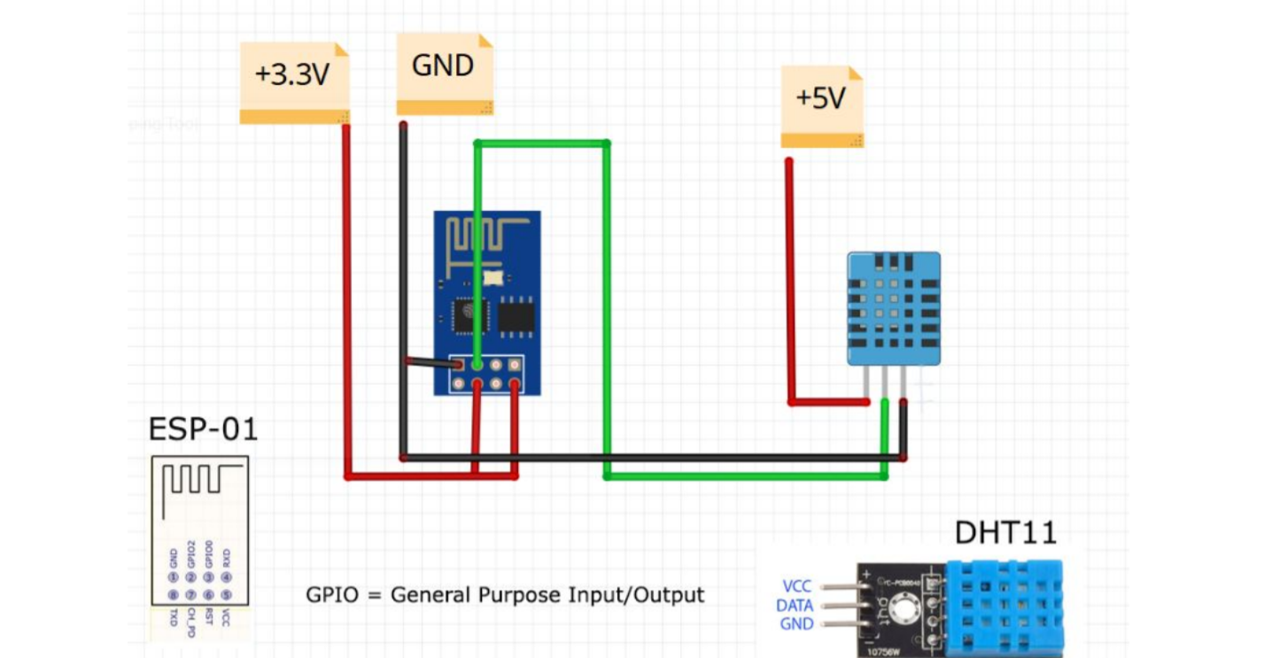
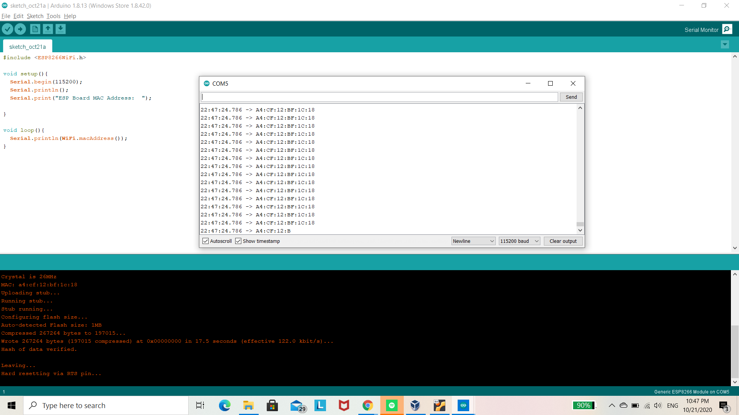
Briefing the ongoing tasks
Ronnel Mattew
01
Data Producer 2 Development
Temperature and Humidity measurements
Select the board to Generic ESP 8266 Module in Arduino IDE
Get Mac address of Receiver ESP01
Disconnect and the adapt and change to UART mode
Data Produce 2 : reference the following code

Slide 11
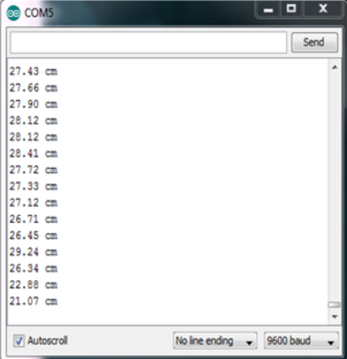
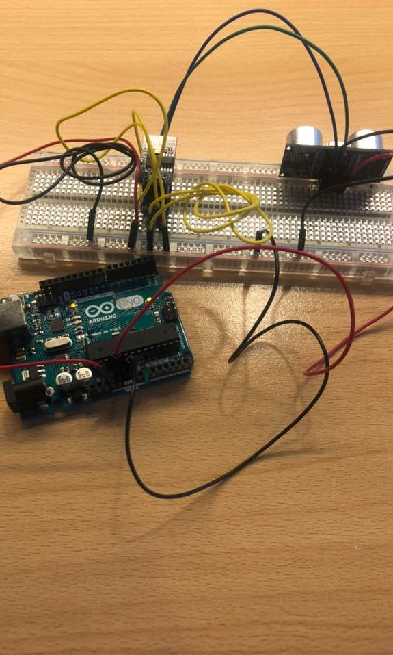
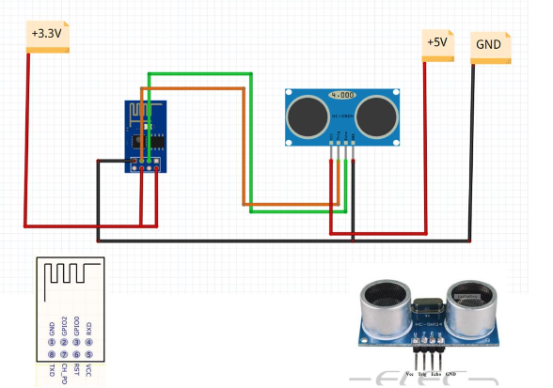
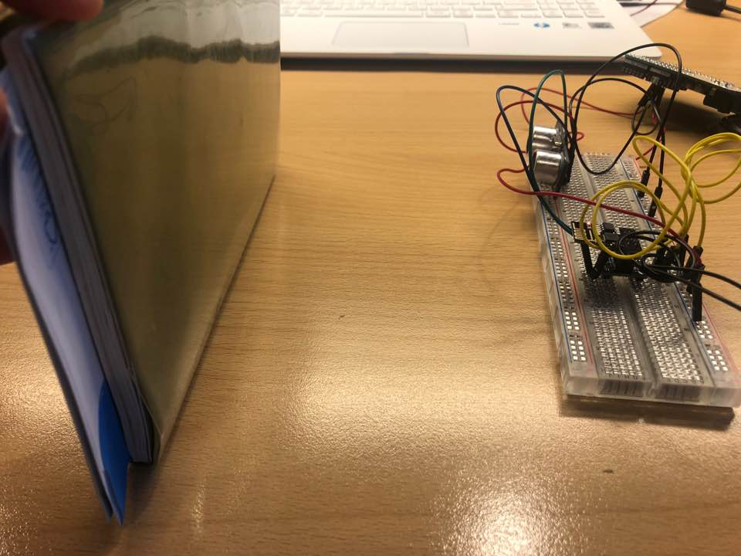
Define the Cheking/ Test Process
ESP01 – Arduino interaction
Data Producer 1 Development
Data Producer 2 Development
Presentation
Briefing the ongoing tasks
Jeongyun Lee
01
Data Producer 1 Development
Repeat the procedure for Receiver ESP
2. Set a ESP01 for Data Producer with following code : https://github.com/jy-977/UBQ-/blob/main/documentation/DataProducer1_documentation.pdf
Electric connection : Use the Arduino just for power supplies
02
Presentation

Slide 12
How to – LCD Screan
How to – PCF 8754
How to – I2C protocol
R.Pi – Arduino interation
Presentation
CO NEW VISION 2020
3rd Sprint
03
PBI
SCRUM SPRINT
Feedbacks

Slide 13
YPTLAB
Logo
UDL MINF
Question
& Answer
THANK
YOU
Thank you For Listening
congue massa. Fusce posuere, magna sed pulvinar ultricies,
purus lectus malesuada

